Slide 1
WATER RESOURCE
Dr. Prasenjit Adak

Slide 2
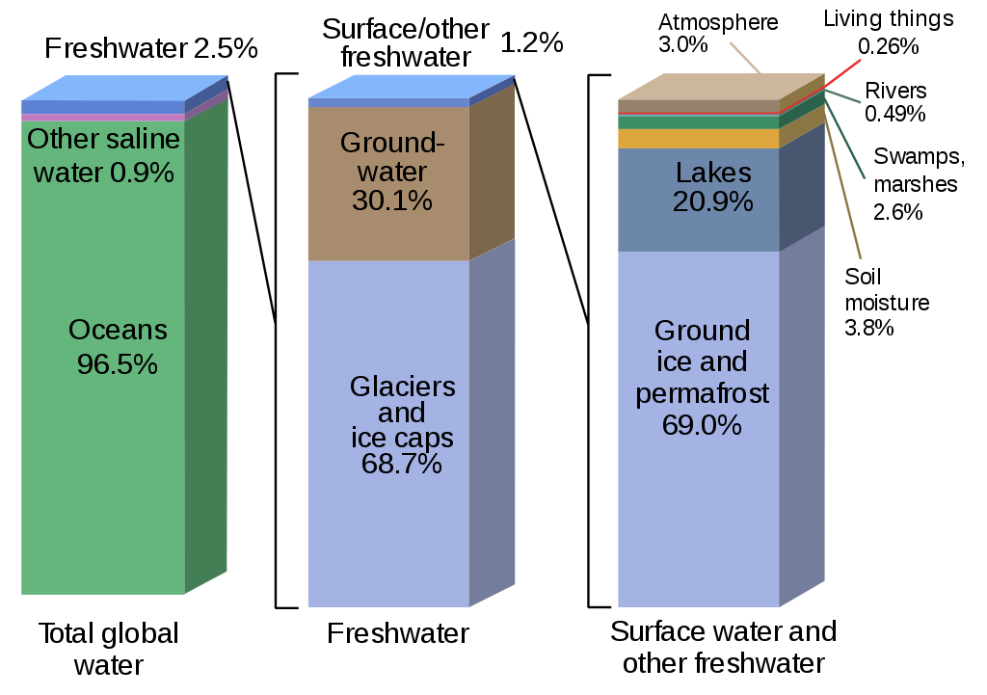
Water Resources
Water availability

Slide 3
Properties of water and its effects
It has the highest specific heat, due to which it warms up and cools down
very slowly without causing shocks of temperature jerks to the aquatic life.
It has a high latent heat of vaporization Hence, it takes a huge amount of energy for getting vaporized. That’s why it produces a cooling effect as it evaporates.
It is an excellent solvent for several nutrients. Thus, it can serve as a very good carrier of nutrients, including oxygen, which are essential for life. But, it can also easily dissolve various pollutants and become a carrier of pathogenic microorganisms.
Due to high surface tension and cohesion it can easily rise through great heights through the trunk.
It has an anamolous expansion behaviour. It is because of this property that even in extreme cold, the lakes freeze only on the surface. Being lighter the ice keeps floating, whereas the bottom waters remain at a higher temperature and therefore, can sustain aquatic organisms even in extreme cold.

Slide 4
Importance of water
Water is the basic component of every living cell.
Water is one of the input required for agriculture.
Industries consume water for cooling, heating and other processes.
Electricity generation
Waterways are used for inland transport.
Water may be used for obtaining common salt.
Water provides habitat to aquatic flora and fauna.

Slide 5
Water usage
Agriculture – 70%, Municipal – 11%, Industrial – 19%
Average requirement is 20 – 40 liter per head per day (Twice of the usage 50 years ago)
About 30% of fresh water is used by US (4% of world population) where, middle east (5% of world population use 1% of fresh water).
More than 1 billion people don’t have fresh water supply.
Presently 31 countries facing water scarcity.
By 2025, 48 countries will face water shortage (including India).
By 2050, 4 billion people will suffer water shortage.

Slide 6
Conflict over water
Tigris and Euphrates conflict (Turkey – Syria – Iraq)
Nile conflict (Egypt – Ethiopia – Sudan)
Jordon river conflict (Israel - Lebanon – Jordon – Palestine)
Aral sea conflict (Kazakhstan – Uzbekistan – Tajikistan – Turkmenistan)
Indus water treaty (Jhelum - Chenab: Pakistan, Satluj, Ravi, Beas: India)
Kaveri dispute
Origins in brahmagiri hill (Karnataka)
Then enters Tamil Nadu
First agreement in 1892
Mettur dam was built in 1970 – Tamil Nadu raised objection
1991 a tribunal is formed – Karnatake opposed
Satluj-Yamuna Link (SYL) canal dispute (Punjab – Haryana)

Slide 7
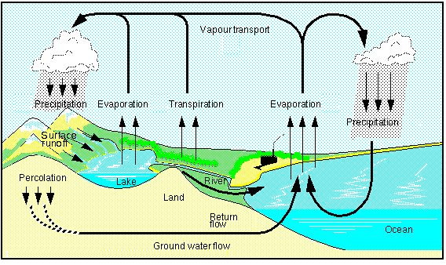
Water cycle

Slide 8
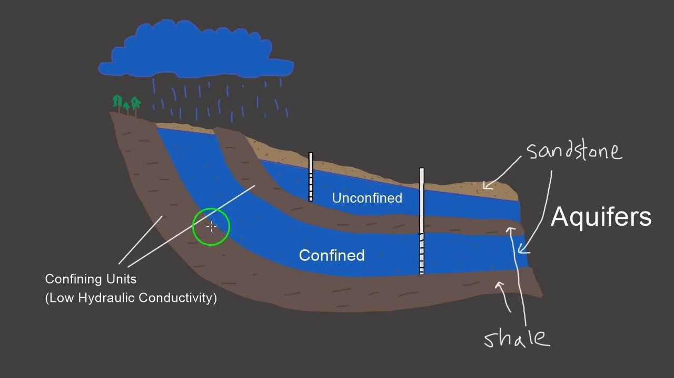
Source of water
Surface water
Rainfall, snow
Ground water
Confined aquifer
Unconfined aquifer
Aquifer
An aquifer is a body of porous rock or sediment saturated with groundwater. Groundwater enters an aquifer as precipitation seeps through the soil. It can move through the aquifer and resurface through springs and wells.

Slide 9
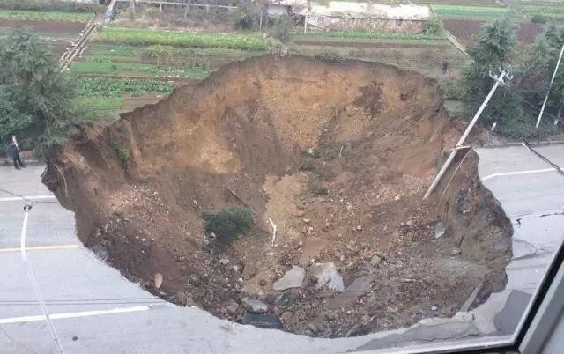
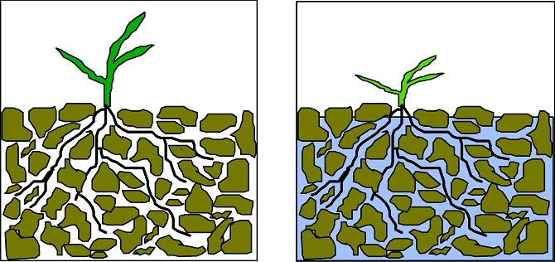
Over exploitation of ground water
Ground subsidence
Lowering water table
Reduced surface water flow
Increased power consumption
Water logging
Ground water pollution

Slide 10
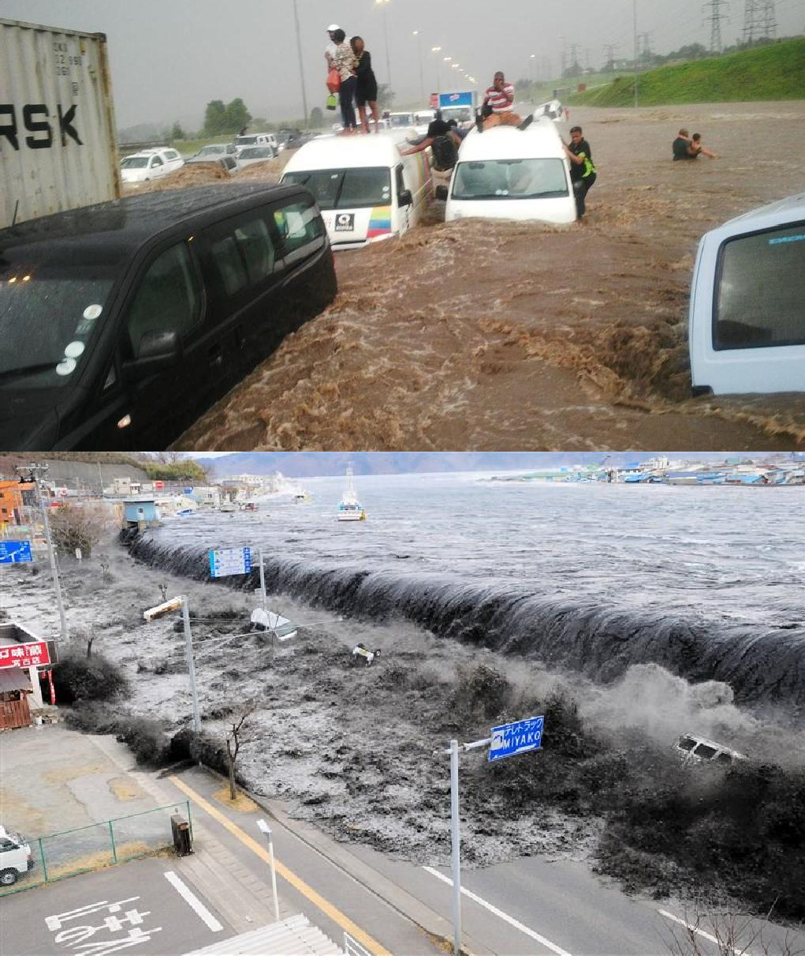
Water calamities (Flood)
Types
Flash flood: Heavy rainfall, dam failure, river obstruction
River flood: Precipitation over large catchment area, melting of snow
Coastal flood: Hurricanes, tropical cyclone, tsunami
Causes
Upslope factors
Melting of snow
Intense rainfall
Time of concentration
Downslope factors
Dams and reservoirs
Tides
Natural events: Tsunami, Storm

Slide 11
Water calamities (Flood)
Effects
Negative effects: Loss of life and property, damage to crops, damage to power transmission, water-borne diseases, difficulty in health facilities, decline in tourism
Positive effects: Distribution of nutrients, relocation of fishes

Slide 12
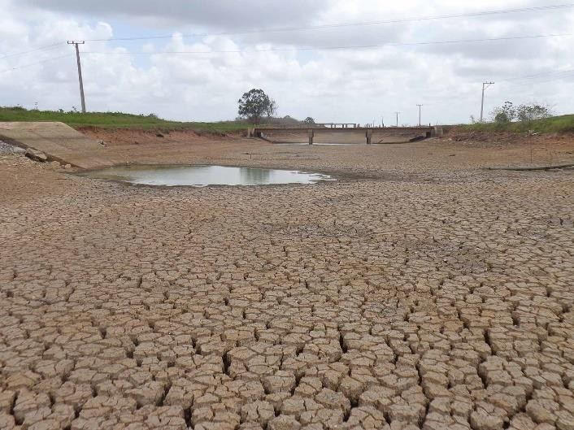
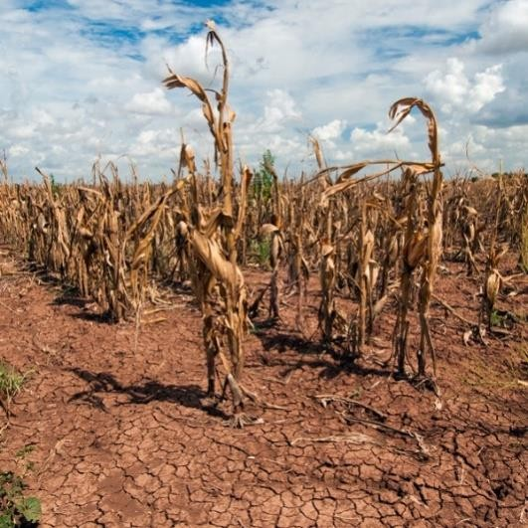
Water calamities (Drought)
Types
Meteorological drought: Less rainfall
Hydrological drought: Low stream flow
Agricultural drought: Low soil moisture
Causes
Dry season
Climate change
Erosion and human activity

Slide 13
Water calamities (Drought)
Effects
Decrease in crop growth
Dust storm
Famine and mal nutrition
Habitat change
Mass migration
Reduced electricity
Wild fire

Slide 14
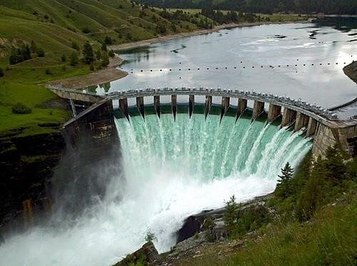
Dams
Benefits
Electricity generation
Employment
Irrigation water supply
Drinking water supply
Reduction in famine
Flood control

Slide 15
Dams
Problems
Displacement of tribal people
Loss of forest
Changes in aquatic environment
Waterlogging near reservoir
Breeding of vectors
Microclimatic changes
Reduced water flow
Flash flood
Salt water intrusion
Sediment carrying nutrients get deposited in reservoir.
Outbreak of vector-borne diseases like malaria.

Slide 16
Thank You

